Slide 1

Link list
Single link list

Slide 2
Single link list
Creation of structure :
truct Node
{
int data;
Node* next_Node;
};

Slide 3
Function for creatin a new node
Node* newnode(int data)
{
Node* new_Node= new Node();
new_Node-> data = data;
new_Node-> next_Node = NULL;
return new_Node;
}
This function return the memory address of new node .

Slide 4
Insertion in a link list
Insertion at back node.
Insertion at any where .
Insertion at first node .

Slide 5
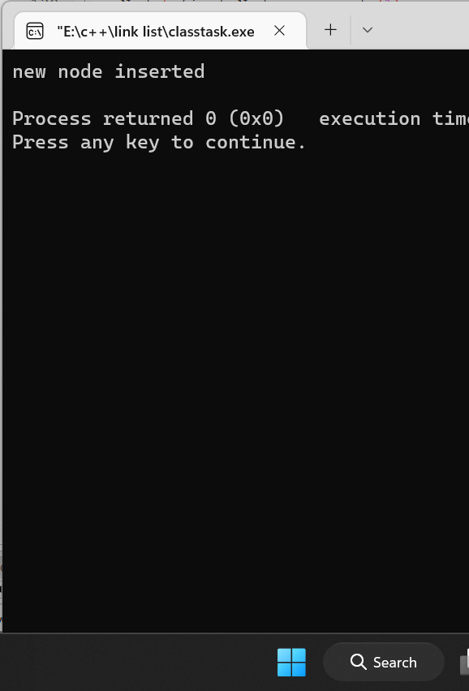
Insertion at back Node
void insert_Back(Node* fn, Node* nn){
Node* current_Node = fn;
while (current_Node->next_Node)
{
current_Node = current_Node->next_Node;
}
current_Node->next_Node = nn;
cout<<"new node inserted"<<endl;
}
int main()
{Node* first_Node = newnode(1) ;
insert_Back(first_Node,newnode(2));
}

Slide 6
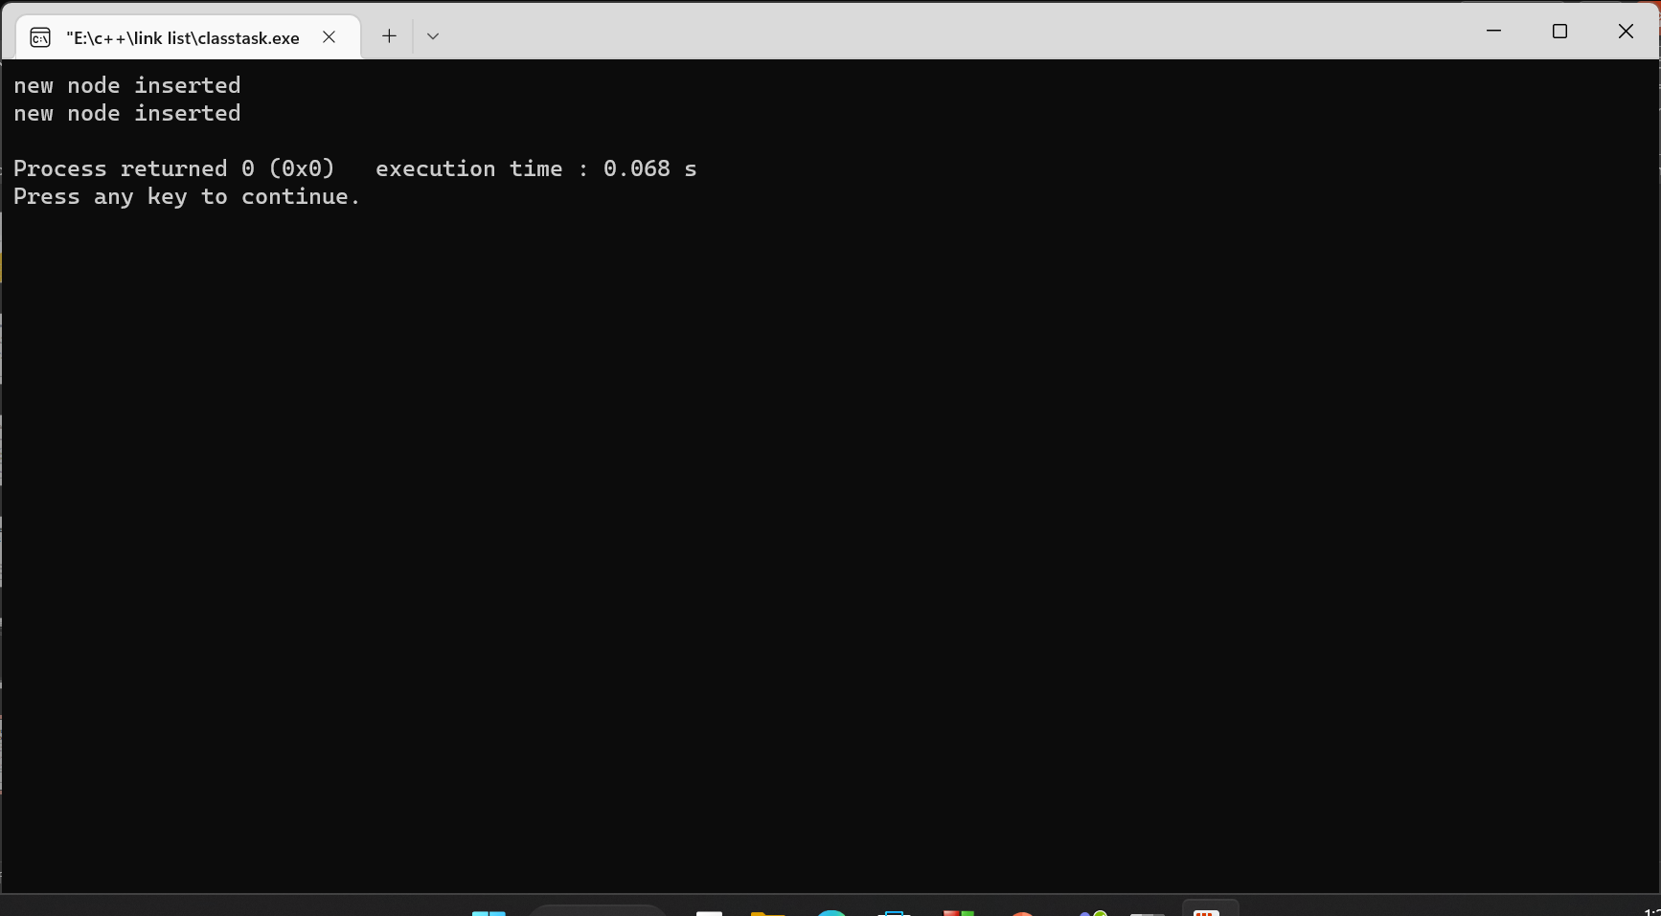
Insertion of a node at any where
void insert_any(Node* fn,Node* nn ,int item){
Node* current_Node=fn;
while(current_Node->data != item)
{
current_Node= current_Node->next_Node;
}
nn->next_Node = current_Node->next_Node;
current_Node->next_Node = nn;
cout<<"new node inserted"<<endl;
}
Int main()
{
Node* first_Node = newnode(1) ;
nsert_Back(first_Node,newnode(2));
insert_any(first_Node,newnode(3),2);
}

Slide 7
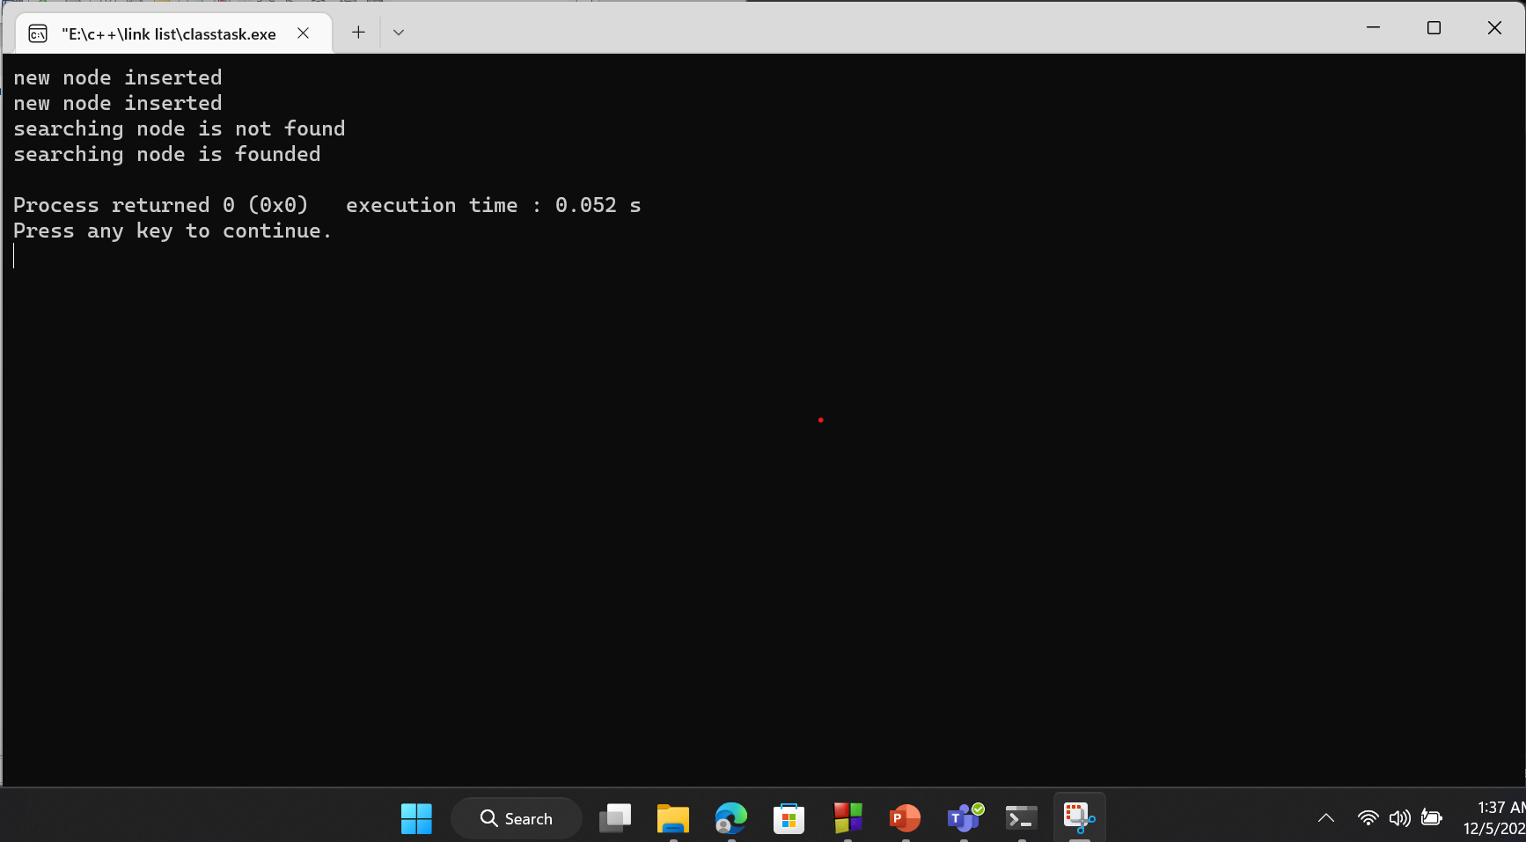
Search an item in link list
Node* searching(Node* fn,int item){
Node* current_Node = fn;
while(current_Node)
{
if(current_Node->data== item )
{
cout<<"searching node is founded"<<endl;
return current_Node;
}
else
{
current_Node = current_Node ->next_Node; }
}
cout<<"searching node is not found"<<endl;
}
int main()
{Node* first_Node = newnode(1) ;
nsert_Back(first_Node,newnode(2));
insert_any(first_Node,newnode(3),2);
}

Slide 8
Delete an item from link list
1.Delete from the list at beginning
2.Delete from the list at middle
3.Delete from the list at last

Slide 9
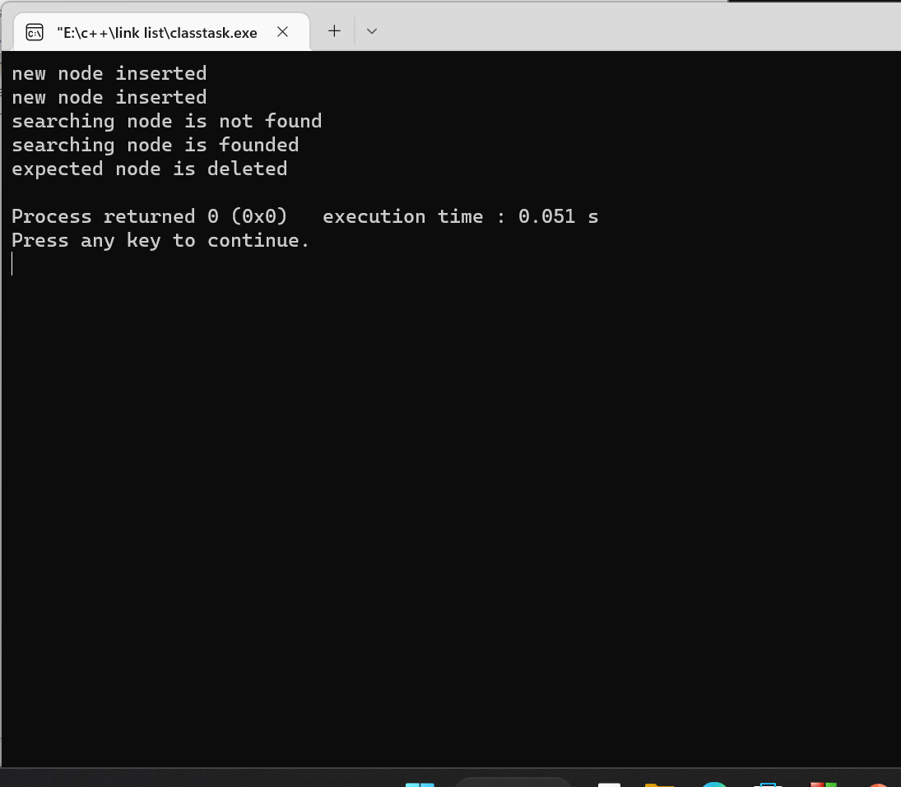
Delete from the list at beginning
Node* del_of_fir_N(Node* fn){
Node* current_Node = fn;
fn = current_Node-> next_Node;
delete current_Node;
cout<<"expected node is deleted"<<endl;
return fn;
}
int main()
{Node* first_Node = newnode(1) ;
nsert_Back(first_Node,newnode(2));
insert_any(first_Node,newnode(3),2);
first_Node = del_of_fir_N(first_Node);
}

Slide 10
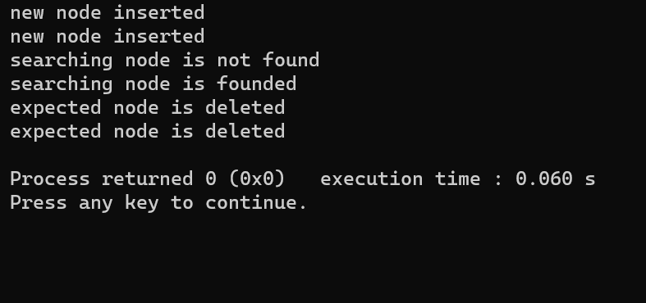
Delete from the list at middle
void del_of_any_N(Node* fn,int item)
{ Node* privious_Node;
Node* current_Node = fn;
while (current_Node->data != item)
{ privious_Node = current_Node;
current_Node = current_Node-> next_Node;
if(current_Node == NULL)
break;}
if(current_Node == NULL)
{ cout<<"Item is not founted"<<endl; }
else{
privious_Node->next_Node = current_Node-> next_Node;
delete current_Node;
cout<<"expected node is deleted"<<endl;
}
}
int main(){i
{Node* first_Node = newnode(1) ;
nsert_Back(first_Node,newnode(2));
insert_any(first_Node,newnode(3),2);
first_Node = del_of_fir_N(first_Node);
del_of_any_N(first_Node,3);
}

Slide 11
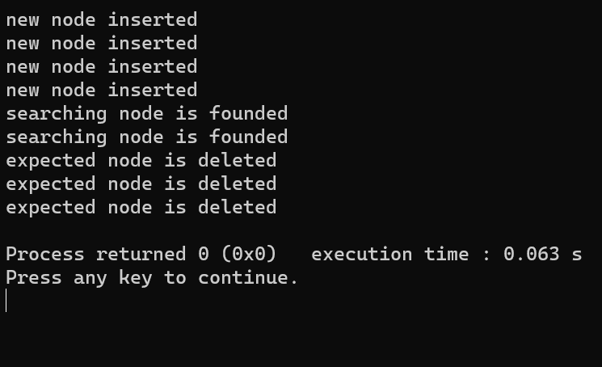
Delete from the list at last
void del_of_last_N(Node* fn)
{Node* privious_Node;
Node* current_Node = fn;
while(current_Node ->next_Node)
{ privious_Node =current_Node;
current_Node = current_Node>next_Node;
}
privious_Node -> next_Node = NULL;
delete current_Node;
cout<<"expected node is deleted"<<endl;
}
int main(){Node* first_Node = newnode(1) ;
nsert_Back(first_Node,newnode(2));
insert_Back(first_Node,newnode(4));
insert_Back(first_Node,newnode(6));
insert_any(first_Node,newnode(3),2);
first_Node = del_of_fir_N(first_Node);
del_of_any_N(first_Node,3);
del_of_last_N(first_Node);}

Slide 12
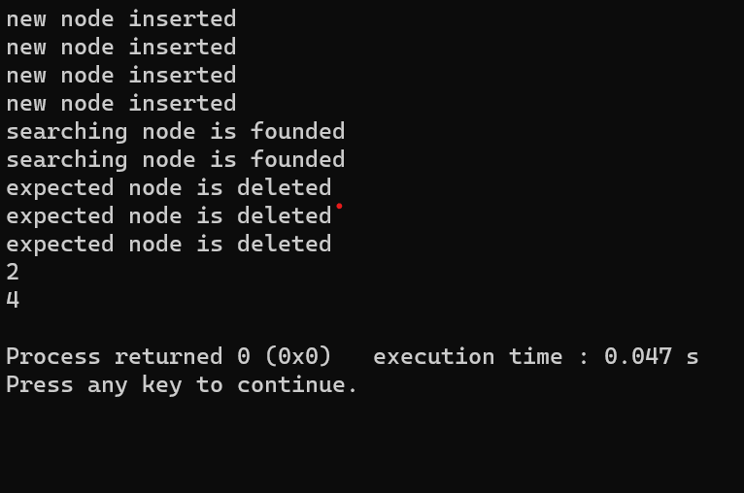
Display the link list
void display(Node* fn){
Node* curent_node = fn;
while(curent_node)
{
cout<< curent_node ->data<<endl;
curent_node = curent_node->next_Node;
} }
int main(){Node* first_Node = newnode(1) ;
nsert_Back(first_Node,newnode(2));
insert_Back(first_Node,newnode(4));
insert_Back(first_Node,newnode(6));
insert_any(first_Node,newnode(3),2);
first_Node = del_of_fir_N(first_Node);
del_of_any_N(first_Node,3);
del_of_last_N(first_Node);
display(first_Node);}

Slide 13
Welcome

